Slide 1
Database Normalization
Database Management System
Notes:
Introduction to the presentation on Database Normalization.

Slide 2

Introduction
Introduction to Introduction
Key concepts related to Introduction
Important aspects of Introduction
Applications and examples of Introduction
Notes:
Explain Introduction in detail, covering key concepts and applications.

Slide 3
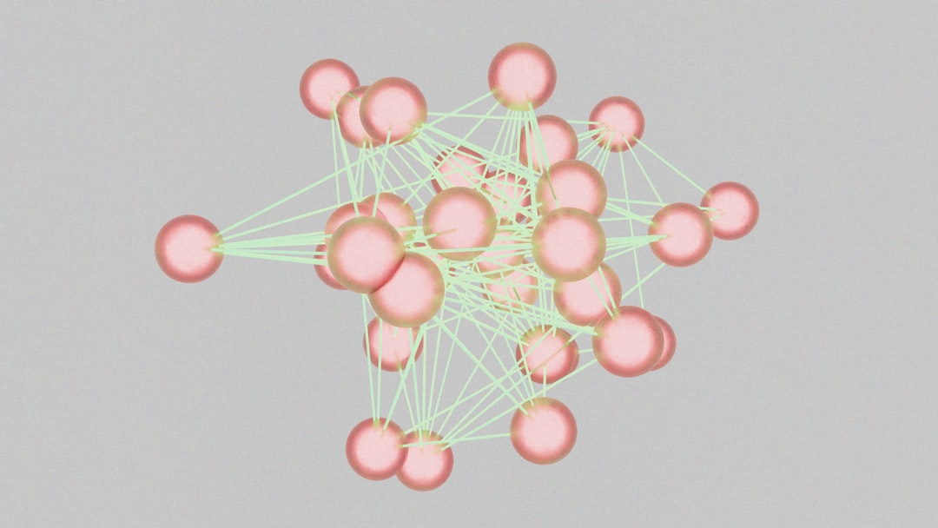
Core Concept / Architecture
Introduction to Core Concept / Architecture
Key concepts related to Core Concept / Architecture
Important aspects of Core Concept / Architecture
Applications and examples of Core Concept / Architecture
Notes:
Explain Core Concept / Architecture in detail, covering key concepts and applications.

Slide 4
Mathematical / Logical Explanation
Introduction to Mathematical / Logical Explanation
Key concepts related to Mathematical / Logical Explanation
Important aspects of Mathematical / Logical Explanation
Applications and examples of Mathematical / Logical Explanation
Notes:
Explain Mathematical / Logical Explanation in detail, covering key concepts and applications.

Slide 5
Applications / Use Cases
Database normalization applies to e-commerce platforms
Social media websites use normalization for data consistency
Normalization is crucial in banking and financial systems
Healthcare databases rely on normalization for patient records
Normalization is used in online education platforms for course management
Customer relationship management systems utilize normalization
Normalization is applied in supply chain management databases
Real-time data analytics systems benefit from normalization techniques
Data warehousing and business intelligence use normalization principles
Notes:
When discussing the applications and use cases of database normalization, emphasize the importance of data consistency and integrity in various industries. Provide examples such as e-commerce platforms and healthcare databases to illustrate the practical applications of normalization. Ask students to consider how normalization would improve data management in their own projects or hypothetical scenarios, and encourage them to think critically about the benefits and challenges of implementing normalization in different contexts.

Slide 6
Summary & Key Takeaways
Database normalization prevents data redundancy and inconsistency
Normal forms ensure data integrity and reduce anomalies
First normal form eliminates repeating groups and arrays
Second normal form eliminates partial dependencies
Third normal form eliminates transitive dependencies
Boyce-Codd normal form ensures higher data integrity
Normalization improves data scalability and flexibility
Denormalization may improve performance in certain cases
Database design requires careful normalization consideration
Notes:
When discussing this slide, emphasize the importance of normalization in database design, provide examples of how normalization can prevent data anomalies, and ask students to consider scenarios where denormalization might be necessary. Encourage students to think critically about the trade-offs between data integrity and performance. Ask questions like 'What are the benefits of normalizing a database?' or 'How might denormalization impact data consistency?' to prompt class discussion.

